Slide 1

Analyzing and Visualizing Global CO2 Emissions for Environmental Impact
This presentation explores the visualization of global CO2 emissions, analyzing trends over time and identifying the major contributors to these emissions. By utilizing interactive visualizations and data analysis conducted in Power BI.
By: Jack Titas w
Mentorness Internship

Slide 2
Objectives
Understand Emission Trends
Analyse Global Co2 data to reveal Patterns and identify key driving factors
Key Contributors
Find the countries, sectors responsible for Majority of emissions
Insights for policymakers
Provide policymakers, researchers and the public to understand emission trends
Raise Public Awareness
communicate the urgency of climate change and to rise awareness.

Slide 3
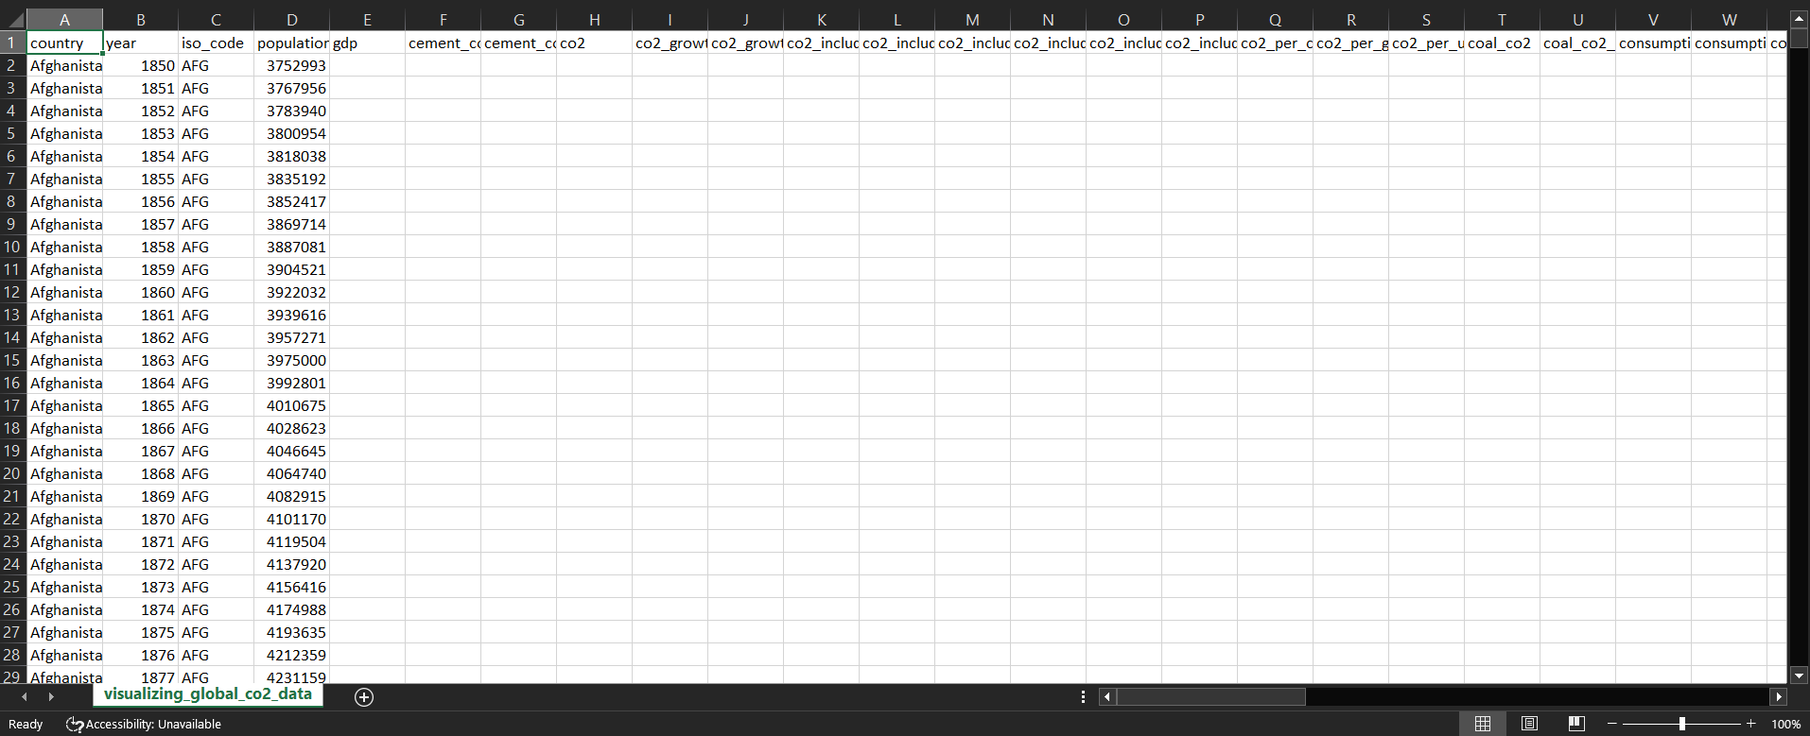
Raw data

Slide 4
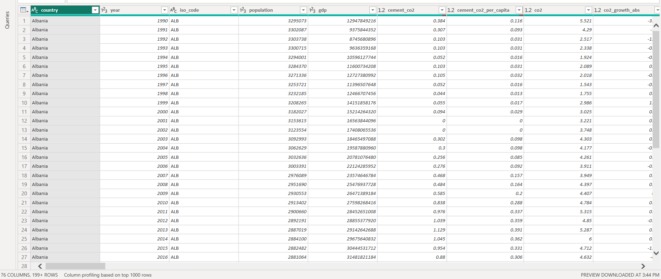
Cleaned data

Slide 5
Steps done to clean raw data
Data processing :- Data processing is the process of collecting, organizing, and manipulating data to create useful information
Data cleaning :- Data cleaning is the process of fixing or removing incorrect, incomplete, or irrelevant data from a dataset
Data Validation :- Data validation is the process of checking the accuracy, structure, and integrity of data before it is used for business operations
Data Reduction :- Reducing the amount of data stored to make it more efficient to store and process
Data Transformation :- Data transformation is the process of converting data from one format or structure to another

Slide 6
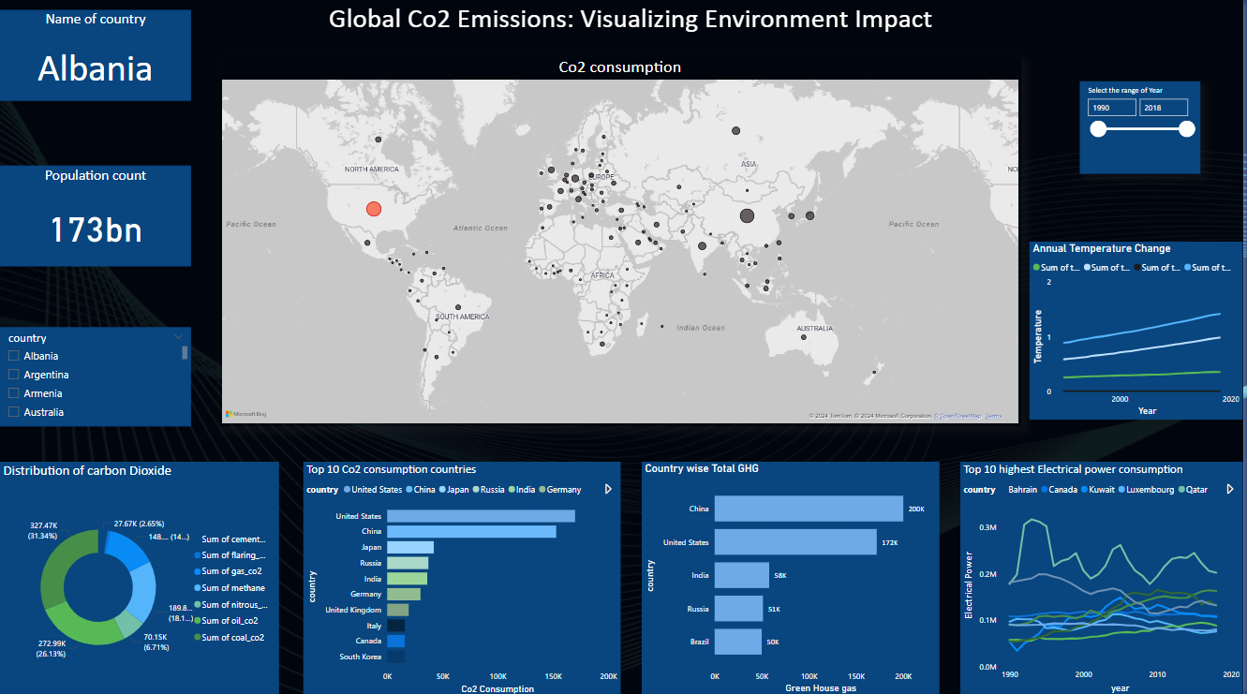

Slide 7
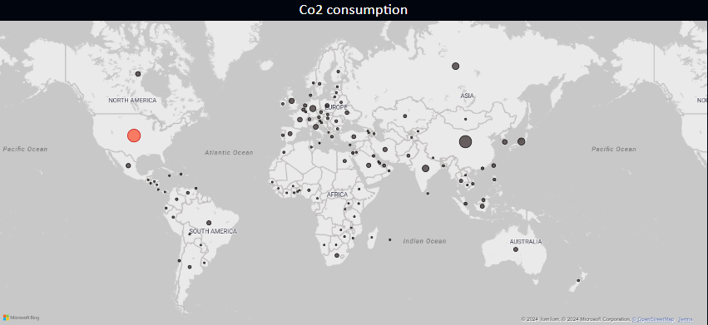
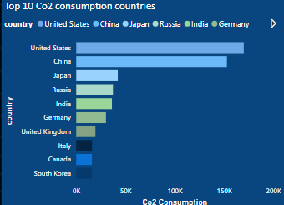
Top 10 Co2 consumption countries
United states Co2 consumption is more compared to other countries
Co2 consumption countries
Comparing emission intensity across various countries

Slide 8
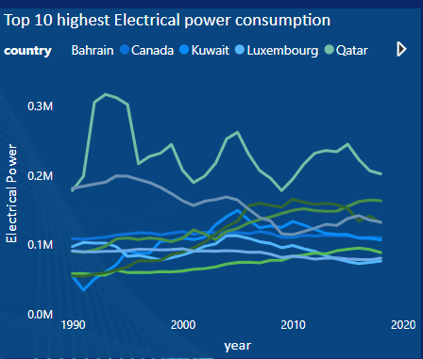
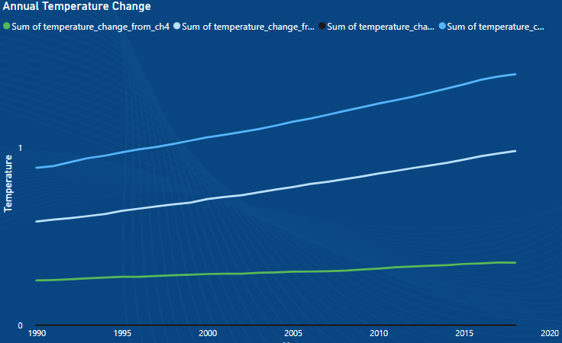
Visualizing top 10 Highest electrical power consumption countries
Top 3 Electrical power consumption countries in 2018
Year | Countries | Power Consumption
2018 | Qatar | 203k
2018 | Singapore | 164k
2018 | Trinidad and Tobago | 142k
Visualizing annual temperature change
In the year of 2018 Temperature change from green house gases is more than other sources

Slide 9
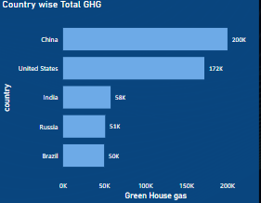
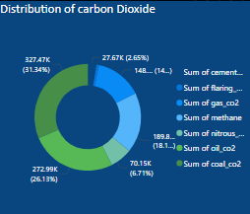
Visualizing country wise total green house gas
China is producing more green house gas than other countries,
China produces a total 200k green house gas
Visualizing Co2 emission from various sources
Co2 produced from Coal is more than other sources
And Co2 produced from cement is comparatively lesser than other sources

Slide 10
Conclusion and Future Considerations
The global CO2 emissions analysis highlighted key contributors and trends, showing that developed and emerging economies are the primary sources of emissions due to industrial activities and energy consumption. Countries like China and United States were identified as major emitters, while regions like Asia showed declining trends due to strong environmental policies.
Future analysis could focus on evaluating the impact of climate policies, sector-wise emissions, and technological innovations to guide efforts in reducing global CO2 levels effectively.

Slide 11
Thank you ❤️

